Slide 1
Saturdays AI La Paz
Deep Learning Edition

Slide 2
Redes
Neuronales Convolucionales
Stanley Salvatierra

Slide 3
Agenda
(19:00 - 20:30) Theory
(20:30 - 20:45) Break
(20:45 - 22:15) Practical Examples
Saturdays.AI La Paz 2/2021

Slide 4

Some History
Google , GPUs, Geofrey Hington, Microsoft, Yan Lecun
Saturdays.AI La Paz 2/2021

Slide 5

Some History
Google , GPUs, Geofrey Hington, Microsoft, Yan Lecun
Saturdays.AI La Paz 2/2021

Slide 6
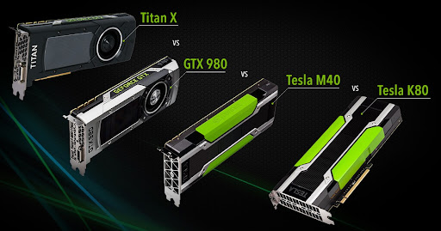
Some History
Google , GPUs, Geofrey Hington, Microsoft, Yan Lecun
Saturdays.AI La Paz 2/2021

Slide 7
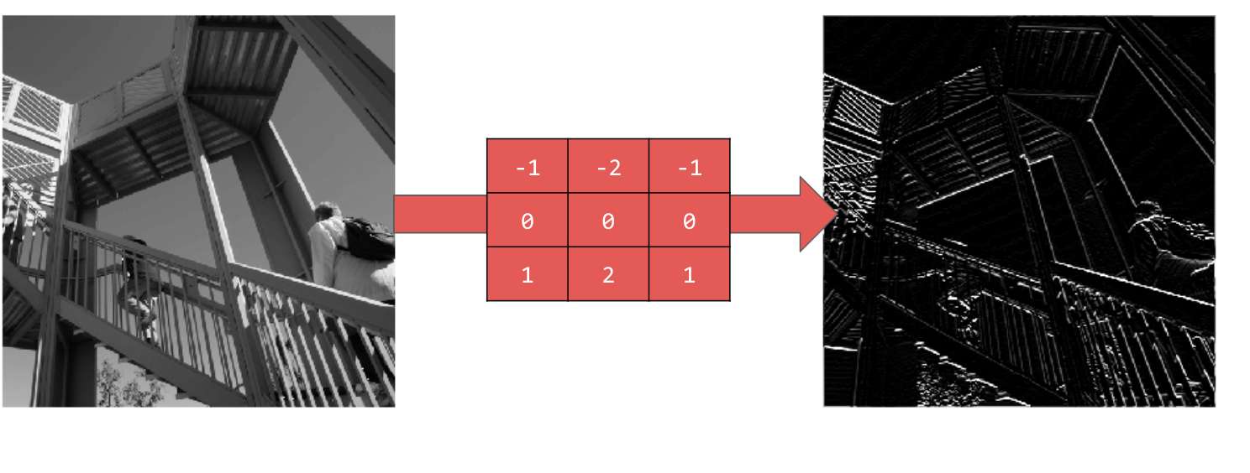
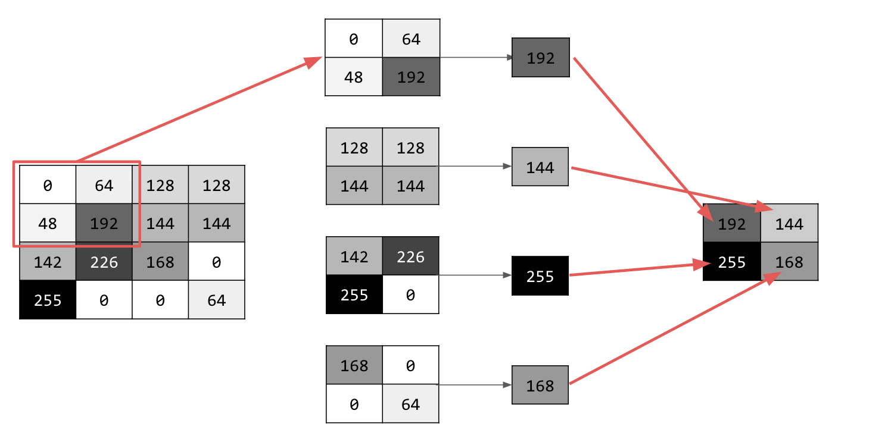
Some Theory
Saturdays.AI La Paz 2/2021

Slide 8
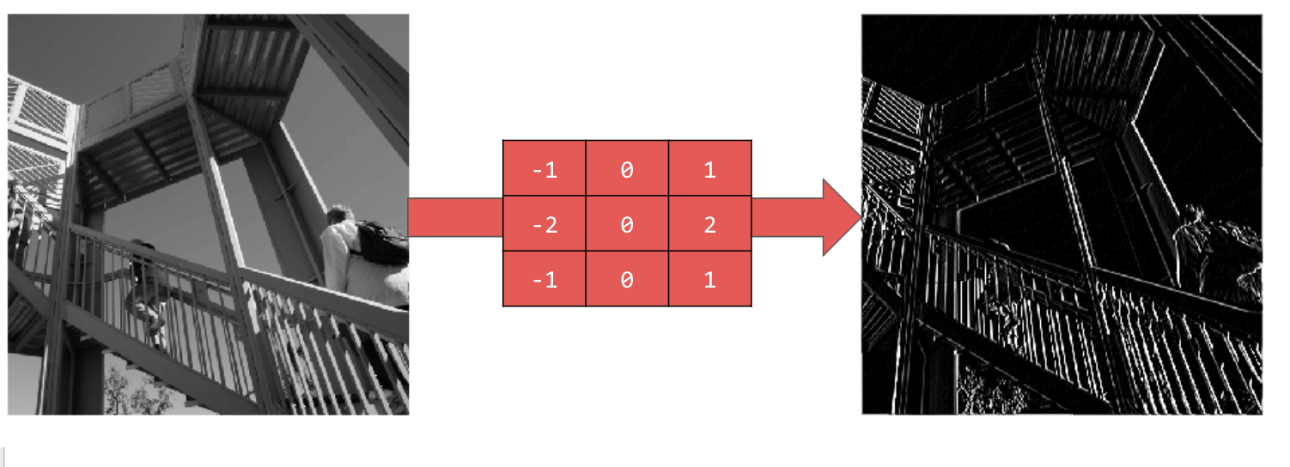
Some Theory
Saturdays.AI La Paz 2/2021

Slide 9
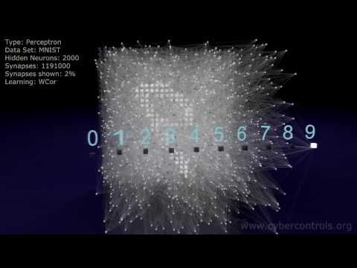
Some Theory
Saturdays.AI La Paz 2/2021

Slide 10
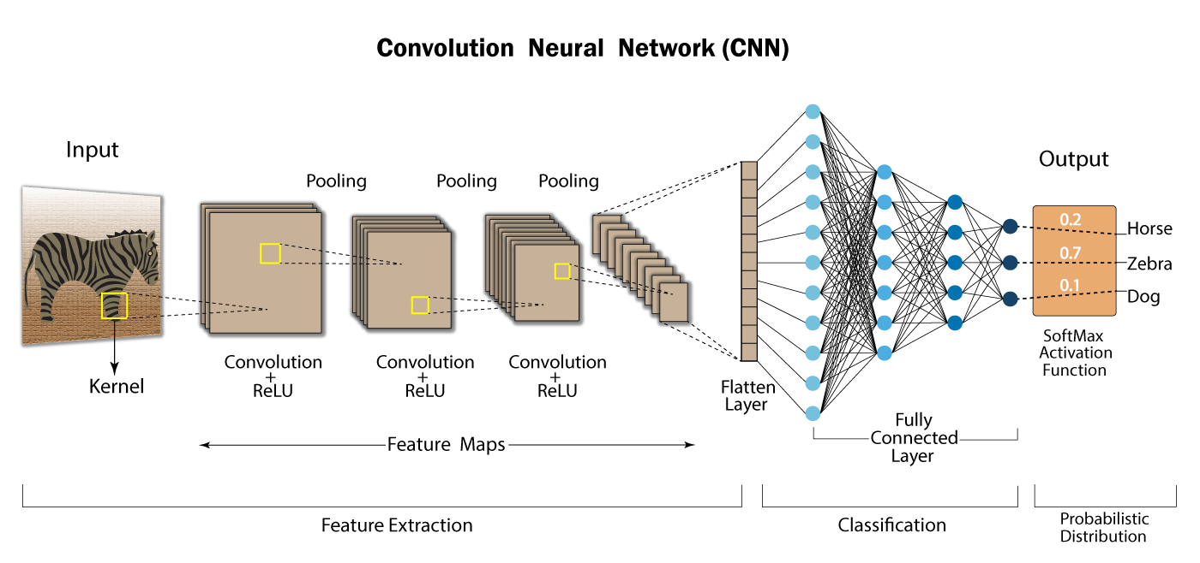
Some Theory
Saturdays.AI La Paz 2/2021

Slide 11
Some Theory
Input Image (RGB, B/N)
Convolutional Layer
Nonlinearity
Pooling Layer
Saturdays.AI La Paz 2/2021

Slide 12
Some Theory (pooling and stride)
A = C x W + b
Saturdays.AI La Paz 2/2021

Slide 13
Some Theory (max. pooling)
Saturdays.AI La Paz 2/2021

Slide 14
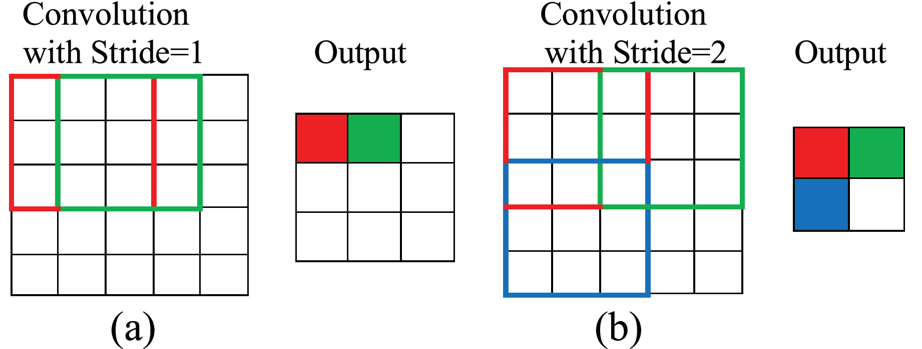
Some Theory (pooling and stride)
Saturdays.AI La Paz 2/2021

Slide 15
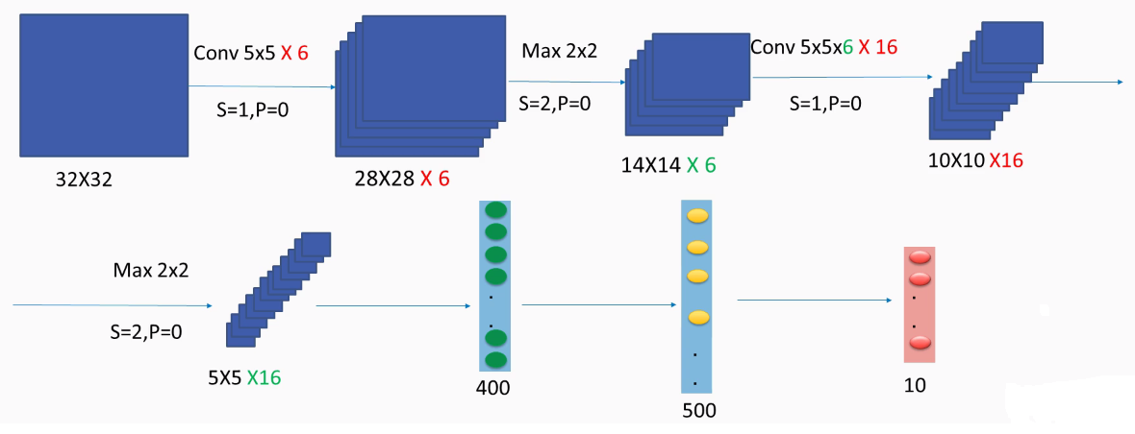
LeNet 5
Saturdays.AI La Paz 2/2021

Slide 16
LeNet
W = height/width
F = filter/kernel size
P = Padding,
S = Stride
output_shape = (W−F+2P)/S+1
Saturdays.AI La Paz 2/2021

Slide 17
LeNet
output_shape = (W−F+2P)/S+1
W = height/width
F = filter/kernel size
P = Padding,
S = Stride
output_shape = (32−5+2*0)/1+1
heightout = 32 − 5 +1 = 28
widthout = 32 − 5 +1 = 28
Saturdays.AI La Paz 2/2021

Slide 18
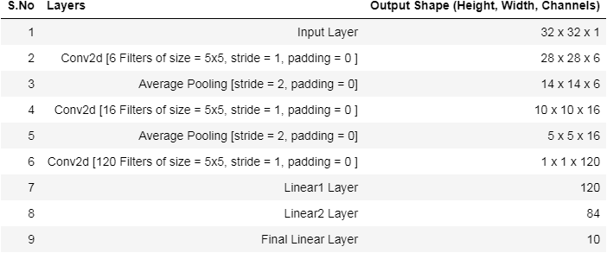
LeNet
https://medium.datadriveninvestor.com/architecture-implementation-of-lenet-from-scratch-in-pytorch-709cc38c00a9
Saturdays.AI La Paz 2/2021

Slide 19
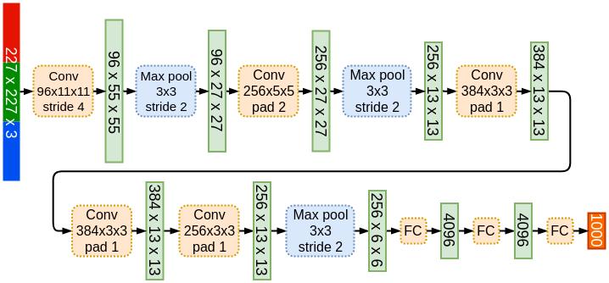
AlexNet
Saturdays.AI La Paz 2/2021

Slide 20
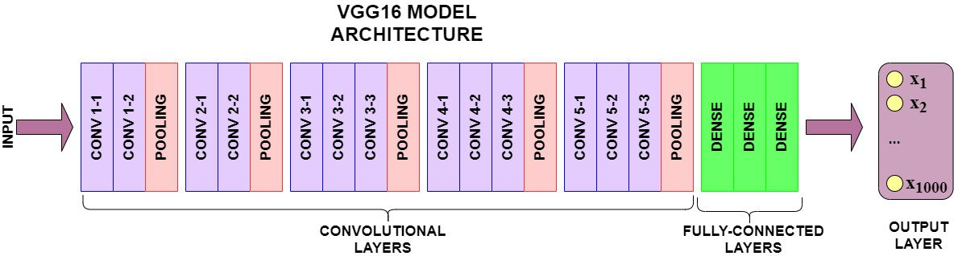
VGG16
Saturdays.AI La Paz 2/2021

Slide 21
VGG16
Saturdays.AI La Paz 2/2021

Slide 22
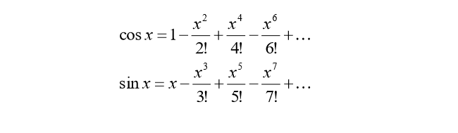
ResNet
Saturdays.AI La Paz 2/2021

Slide 23
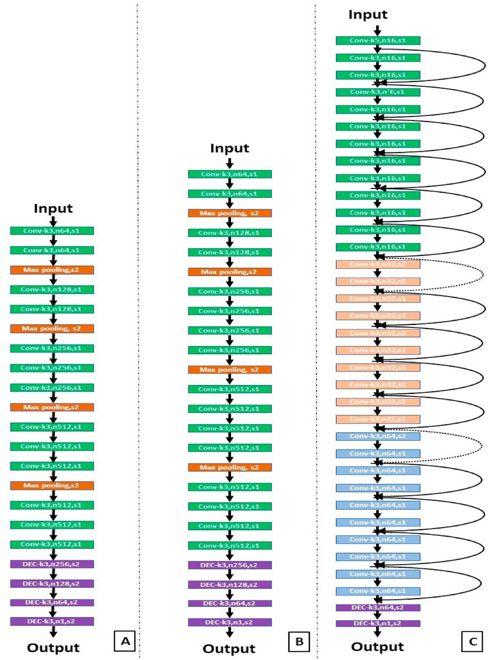
ResNet
Saturdays.AI La Paz 2/2021

Slide 24
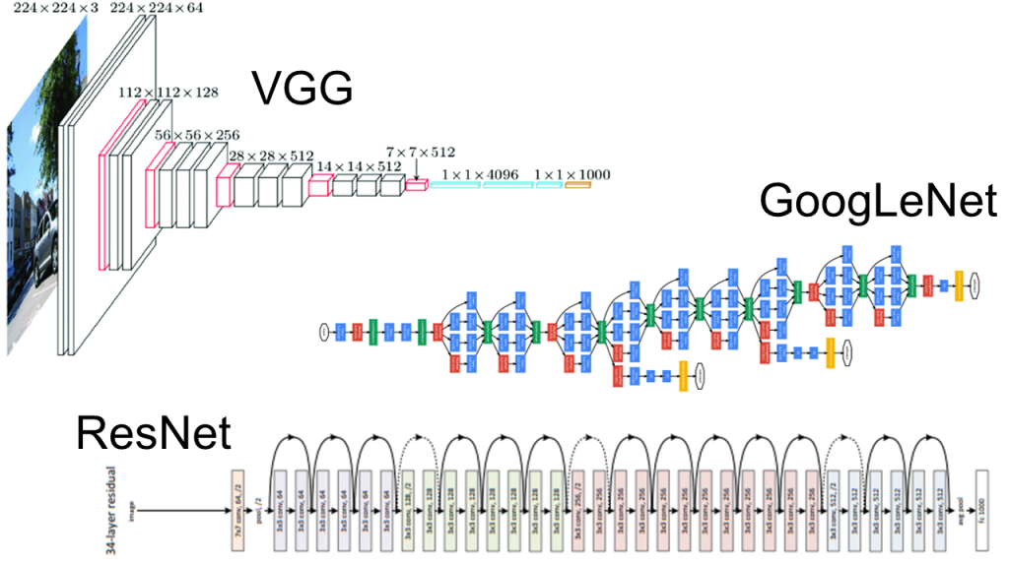
ResNet
Saturdays.AI La Paz 2/2021

Slide 25
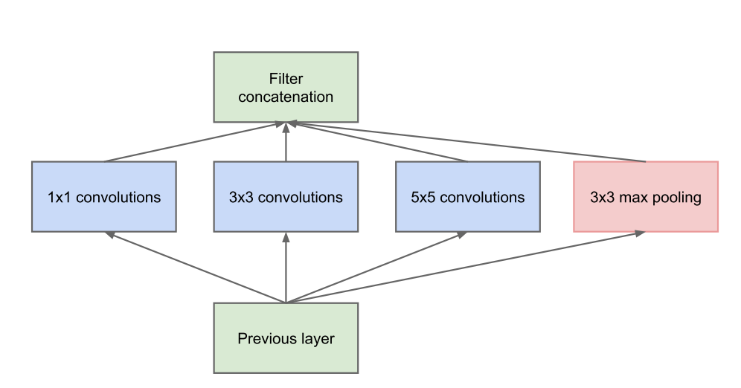
Inception Module
Saturdays.AI La Paz 2/2021

Slide 26
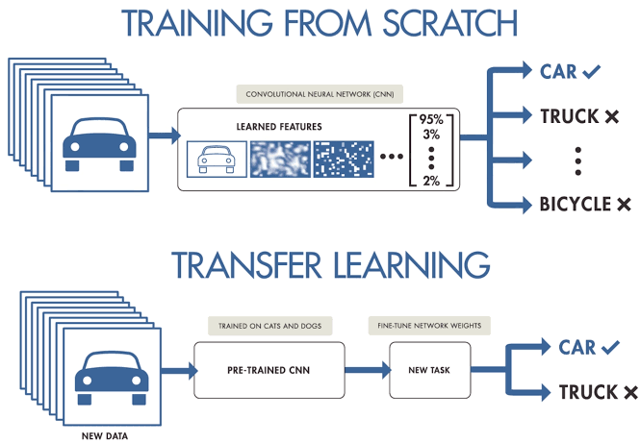
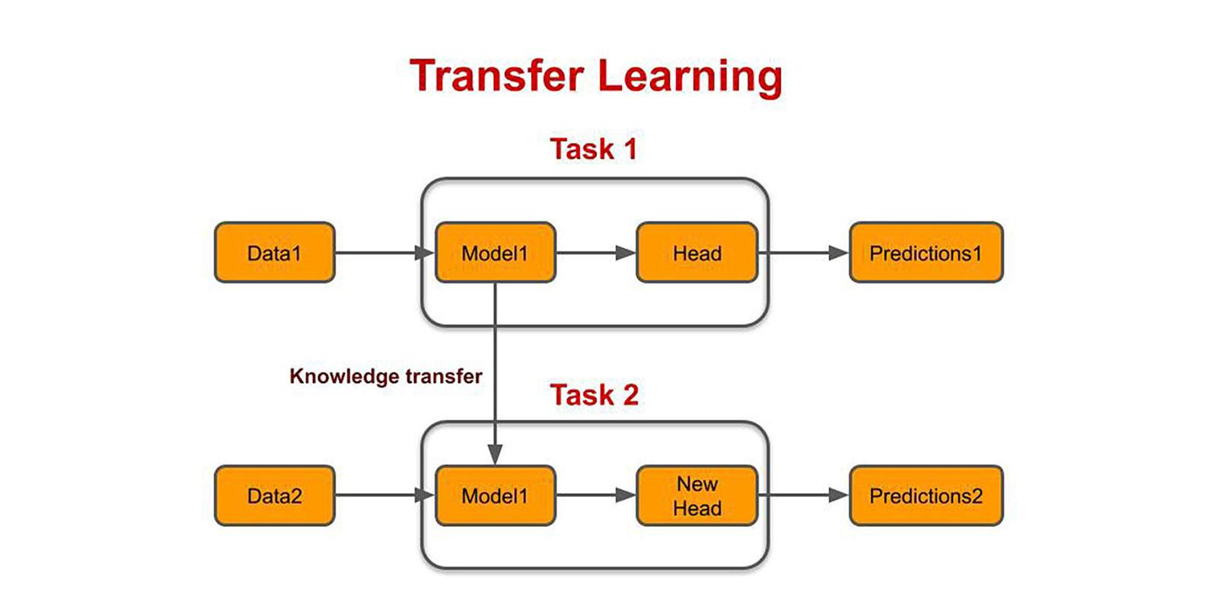
Transfer Learning
Saturdays.AI La Paz 2/2021

Slide 27
Transfer Learning
Saturdays.AI La Paz 2/2021

Slide 28
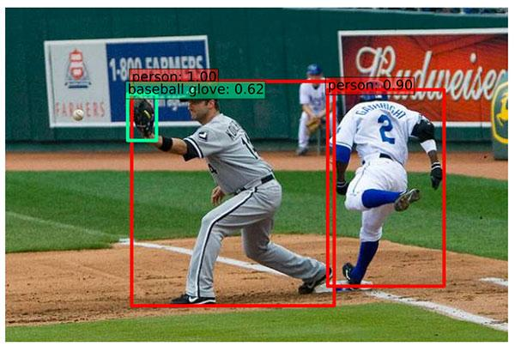
Transfer Learning
Saturdays.AI La Paz 2/2021

Slide 29
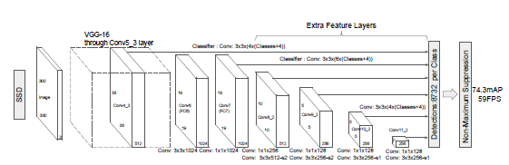
Transfer Learning
Practical Deep Learning for Coders
https://github.com/fastai/fastbook
Saturdays.AI La Paz 2/2021

Slide 30

Practical Examples
https://github.com/bentrevett/pytorch-image-classification
Saturdays.AI La Paz 2/2021

Slide 31
Volvemos:
10:45 UTC - 4

Slide 32
¿Preguntas?

